Slide 1
Capstone Project
Credit Card Default Prediction

Slide 2
Content
Checking the data
Checking Defaulters ratio
Gist of Age and Credit limit
Clients in each Age group
Defaulters with different category wise
2. Implementing Classification techniques

Slide 3
Problem Statement
Predicting if a customer will default the payment

Slide 4
Data Summary
Data set name – default of credit card clients
Shape of combined Dataset- 30000 rows, 26 columns
Columns - 'ID', 'LIMIT_BAL', 'SEX', 'EDUCATION', 'MARRIAGE', 'AGE', 'PAY_0', 'PAY_2', 'PAY_3', 'PAY_4', 'PAY_5', 'PAY_6', 'BILL_AMT1', 'BILL_AMT2', 'BILL_AMT3', 'BILL_AMT4', 'BILL_AMT5', 'BILL_AMT6', 'PAY_AMT1', 'PAY_AMT2', 'PAY_AMT3', 'PAY_AMT4', 'PAY_AMT5', 'PAY_AMT6', 'defaulters', 'AGE_BIN'

Slide 5
Cleaning dataset
All the values were already non null

Slide 6
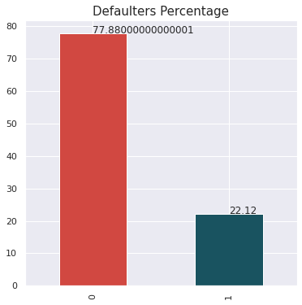
Defaulter’s Ratio
so we have 22% defaulters in our dataset and 77% persons are non defaulters

Slide 7
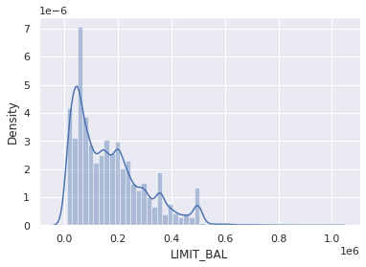
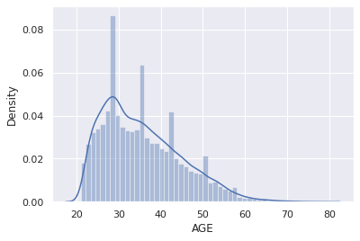
Gist of Age and Credit limit
The data shows that most people are of age range 20-40 and a few only from 50-60 age group
The data shows that most people are with 10-20K of credit limit

Slide 8
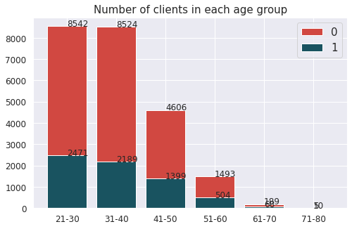
Clients in each Age group
We have maximum clients from 21-30 age group followed by 31-40.
Hence with increasing age group the number of clients that will default the payment next month is decreasing.

Slide 9
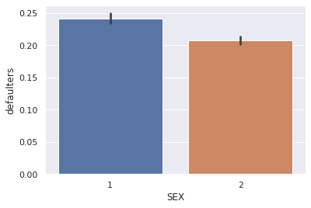
Defaulters with different category
- SEX
So we have more male defaulters

Slide 10
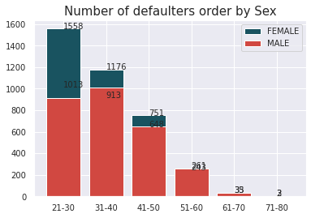
Defaulters with different category
- SEX
we have female defaulters more than males in some age groups ranging 21-50 years

Slide 11
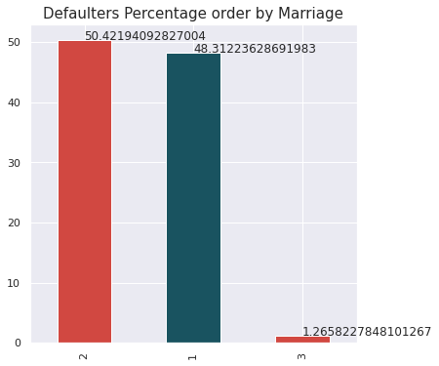
Defaulters with different category
- MARRIAGE
We can see there is no trend or behavior of married or unmarried people as a defaulter.

Slide 12
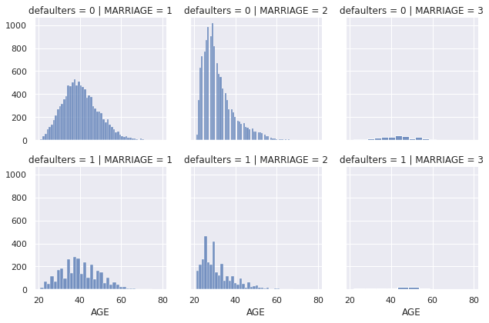
Defaulters with different category
- MARRIAGE
Married people between the age of 30-35 have maximum chances of being defaulters, same for unmarried, which confirms marriage is not the case, Age is.

Slide 13
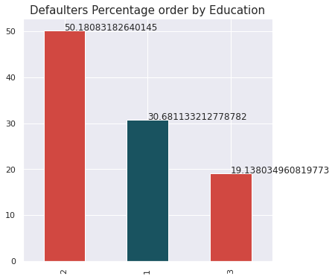
Defaulters with different category
- EDUCATION
University level student tend to default more followed by graduate and high school students

Slide 14
Classification
With unbalanced Dataset
(Recall is more imp in this problem case)
With balanced Dataset
(Recall is more imp in this problem case)
Random Forest:-
Recall– 37%
AUC score – 66%
XGBoost
Recall– 38%
AUC score – 66%
Random Forest:-
Recall – 83%
AUC score – 87%
KNN:-
Recall– 9%
AUC score – 53%
KNN:-
Recall – 82%
AUC score – 80%

Slide 15
Conclusions
we have 22% defaulters in our dataset and 77% persons are non defaulters
The data shows that most people are of age range 20-40 and a few only from 50-60 age group
Most people are with 10-20K of credit limit
We have maximum clients from 21-30 age group followed by 31-40.
With increasing age group the number of clients that will default the payment next month is decreasing
There is no trend or behavior of married or unmarried people as a defaulter.
we have overall more male defaulters but female defaulters are more than males in some age groups ranging 21-50 years
Recall is the best accuracy metrics here, because if the algorithm will not detect the defaulters, that will encounter more loss to the bank
Random Forest with SMOT gives the maximum Recall of 83% in this case

